Slide 1
RESEARCH PROJECT REPORT IN FULFILMENT OF SUMMER INTERNSHIP PROJECT
TOPIC:
GST REGISTRATION
SUBMITTED BY: SUBMITTED TO:
Saniya Usmani Shashwat Singhal

Slide 2
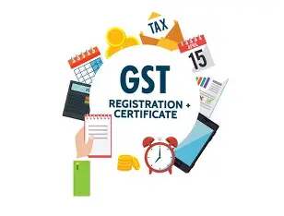
GST REGISTRATION
GST registration is the process of enrolling a taxpayer under the GST regime.
After registration, a unique identification number called GSTIN (Goods and Services Tax Identification Number) is issued.

Slide 3
GSTIN(GST IDENTIFICATION NUMBER)
GSTIN is a 15-digit number that is used for:
Filing GST returns
Collecting GST from customers
Claiming input tax credit
Conducting interstate business legally
Without GST registration (when required), a business cannot legally collect GST.

Slide 4
STRUCTURE OF GSTIN
22AAAAA0000A1Z5
1–2 digits
State code (as per Indian Census)
Example: 09 = Uttar Pradesh
3–12 digits
PAN of the taxpayer (Permanent Account Number)
13th digit
Number of registrations within a state (by same PAN)
14th digit
Default “Z” (kept for future use)
15th digit
Check code (used for error detection)

Slide 5
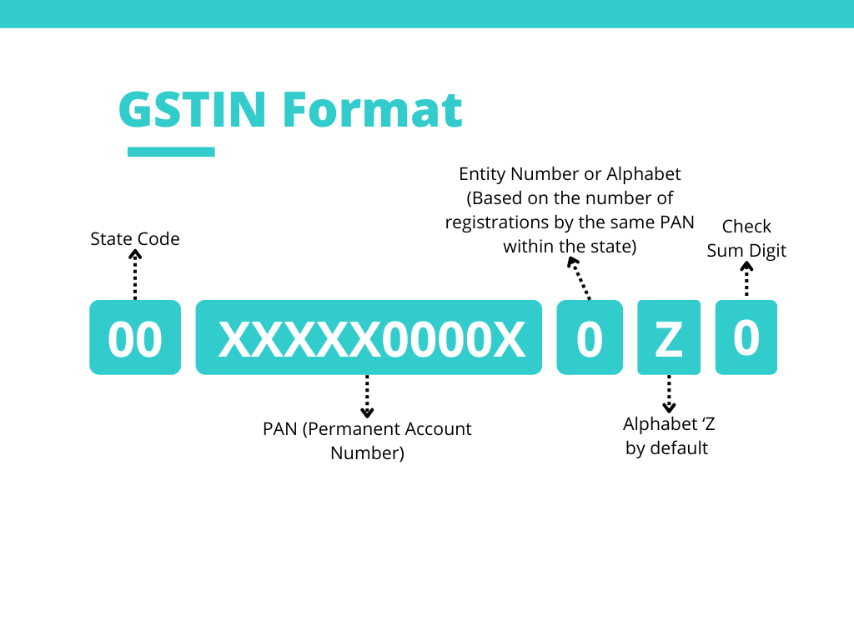

Slide 6
WHO SHOULD REGISTER UNDER GST
1. Turnover-Based Registration
Businesses with turnover above:
  ₹40 lakhs (goods in most states)
  ₹20 lakhs (services in most states)
  ₹10 lakhs (special category states)
2. Mandatory Cases:
Inter-state suppliers of goods/services
E-commerce sellers
Casual taxable persons
Non-resident taxable persons
Businesses liable under reverse charge mechanism

Slide 7
3. Voluntary Registration:
Businesses below the threshold can also register voluntarily to:
Claim input tax credit
Increase business credibility

Slide 8
TYPES OF GST REGISTRATION
1. Normal Taxpayer
2. Composition Scheme
3. Casual Taxable Person
4. Non-Resident Taxable Person
5. Input Service Distributor

Slide 9
DOCUMENTS REQUIRED FOR GST REGISTRATION
The following documents are required:
For Individual / Proprietor:
PAN card
Aadhaar card
Photograph
Bank account details
Address proof (electricity bill, rent agreement, etc.)

Slide 10
For Companies:
Certificate of incorporation
PAN of company
MOA & AOA
Authorized signatory details
Bank details
For Partnership Firms:
Partnership deed
PAN of firm and partners
Address proof

Slide 11
PROCEDURE FOR GST REGISTRATION
GST registration is done online through the official GST portal.
Steps:
Visit GST portal (gst.gov.in)
Click on “New Registration”
Fill Part A:
  PAN
  Mobile number
  Email ID
Receive OTP verification
Get Temporary Reference Number (TRN)

Slide 12
Fill Part B:
  Business details
  Bank details
  Address proof upload
Upload documents
Submit application
After verification, the tax officer approves the application and issues GSTIN.

Slide 13
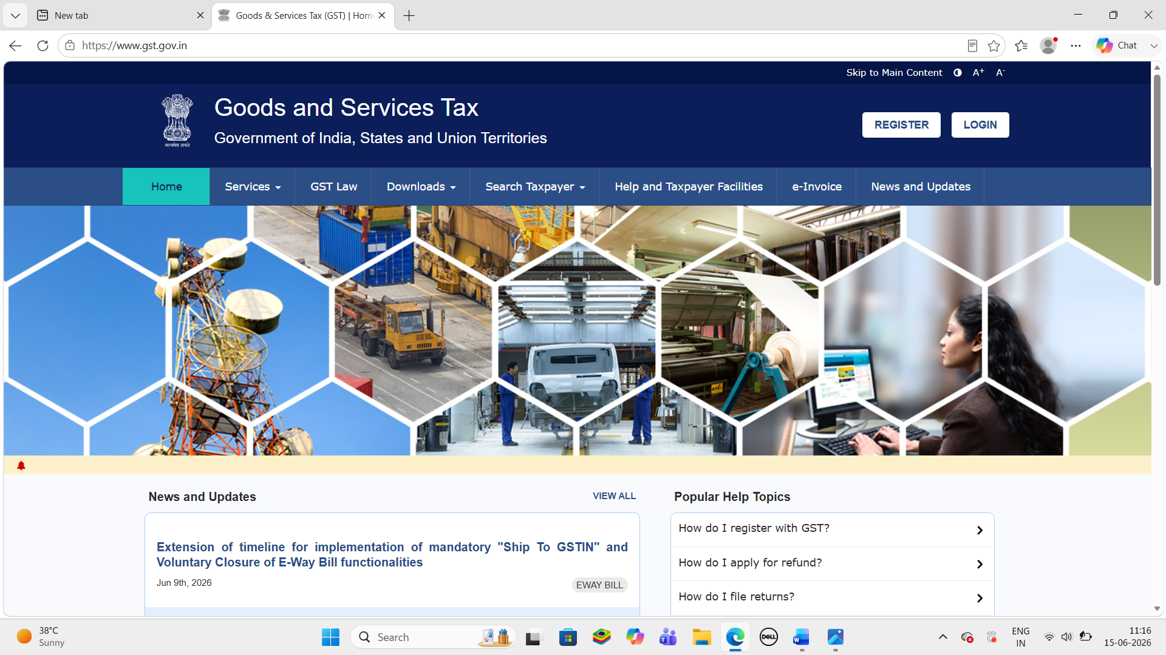
GST WEBSITE

Slide 14
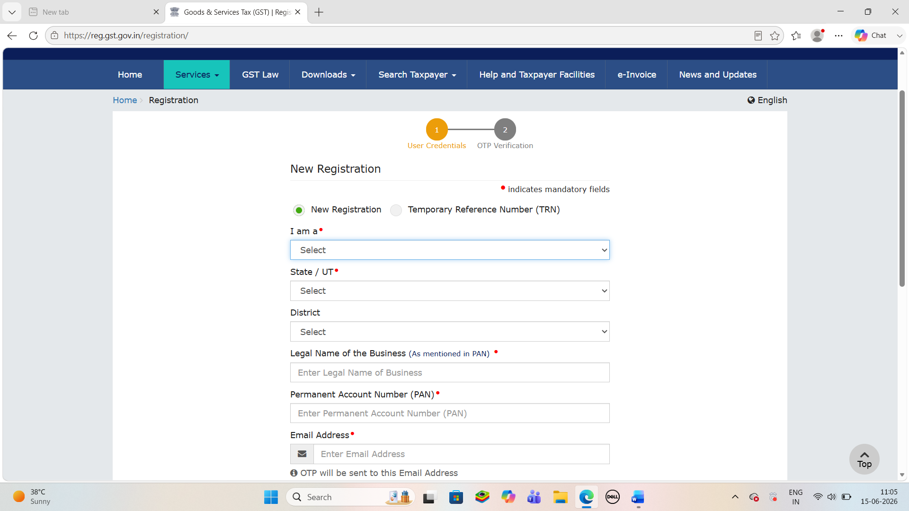
NEW REGISTRATION WINDOW

Slide 15
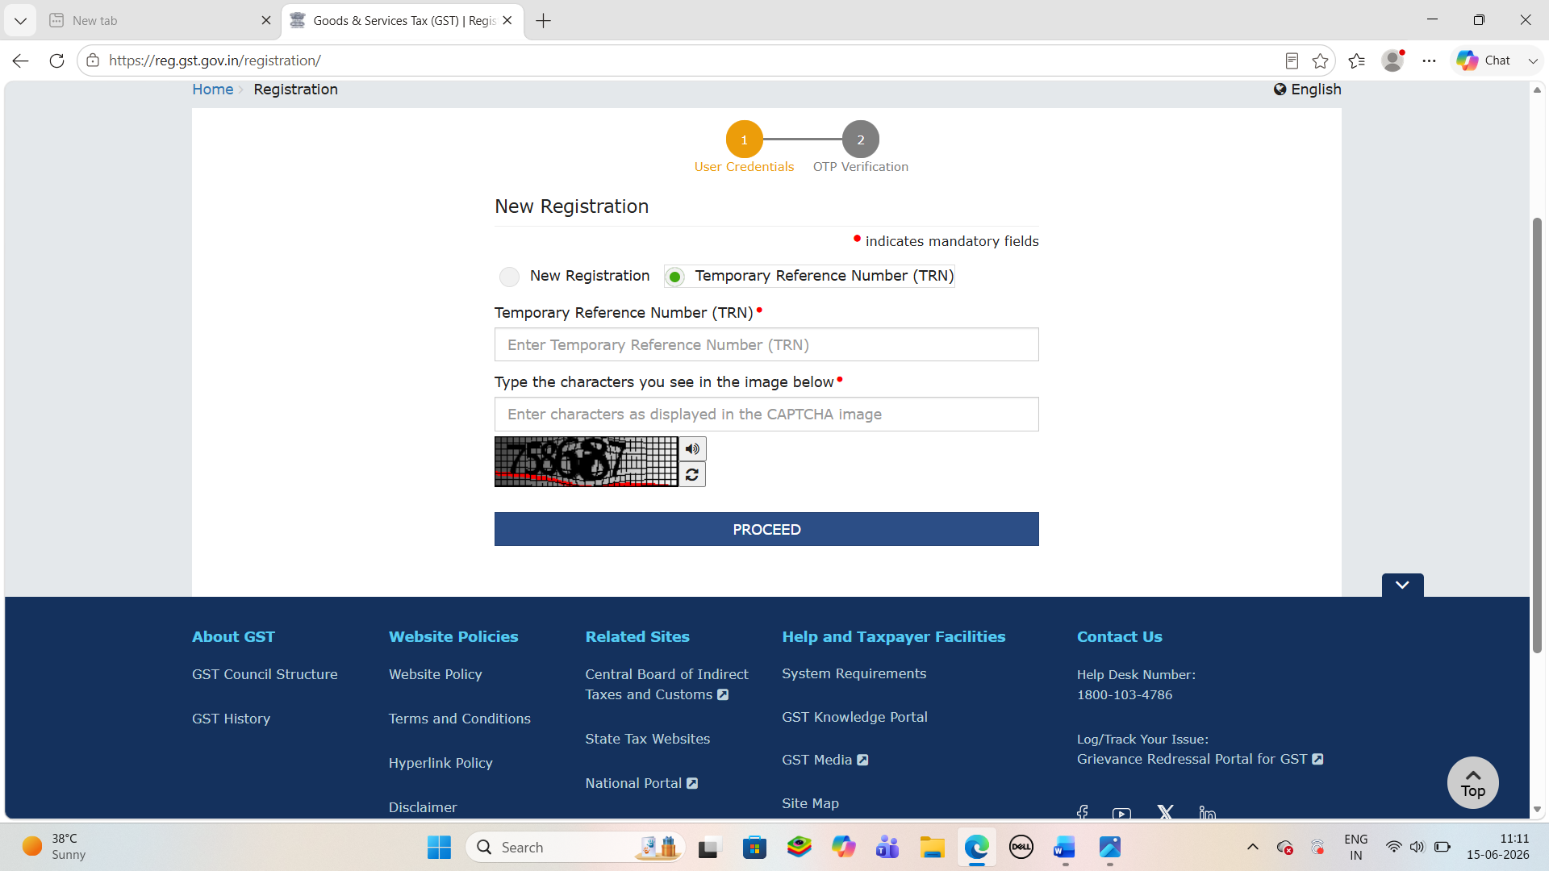
TEMPORARY REFRENCE NUMBER (TRN)

Slide 16

Conclusion:
GST registration is an essential part of India’s modern tax system. It ensures transparency, reduces tax evasion, and simplifies indirect taxation. Every eligible business must register under GST to operate legally and benefit from the input tax credit system.
GST has significantly improved the efficiency of India’s tax structure and promoted a unified national market.

